Slide 1
Noise, Barriers, Feedback, Listening Skills and Grapevine Communication
Dr.Unais KT

Slide 2
Noise
Noise can be defined as physical sound or mental disturbances that disrupts the flow of communication as the sender or the receiver gets distracted by it.
According to this definition noise can be classified into two Categories:
1. Physical
2. Psychological

Slide 3
Physical Noise
Physical Noise is that sound which originates from the surroundings and hampers the listening process.
For example, while speaking on the telephone, disturbances from outside or inside the connectivity may hinder the smooth transmission of message.

Slide 4
Psychological Noise
It basically takes place due to the unwelcomed ideas or thought in mind
Ex: Mental Disturbances, Anxiety, Tiredness and Pre-conceived ideas and Notions

Slide 5
Remedies
Types | Causative Factors | Remedies
Physical | Disturbances and distractions in the environment | Ensuring that all channels are clear and free of noise
Psychological | Mental Disturbances, Anxiety, Ego and Prejudices | Entering into Question/Answer Sessions, Securing Advice

Slide 6
Barriers to Communication
Things which are obstacle to the effective communication process is called Barriers.
Anything that impedes free flow of ideas
It can be classified into two categories:
1. Sender-oriented
2. Receiver-oriented

Slide 7
Sender-Oriented Barriers
Sender-oriented Barriers can be Voluntary or involuntary. Some of the Sender-Oriented barriers are as follows:
1. Badly expressed message: The sender may not be able to structure ideas accurately and efficiently.
2. Loss in transmission: If the choice of channel or medium is not right, the impact of the message is lost.
3. Semantic problem: High or big sounding words may hinder the communication process. The problem arises when one can’t comprehend the meaning

Slide 8
Continue…
4. Over/Under-communication: Excess/under information may confuse the audience.
5. “I” Attitude: “I” centric individual will not be receptive.
6. Prejudices: Starting any piece of communication with a bias or know it all attitude can prove to be quite harmful to the communication process.

Slide 9
How to get rid of it (Remedies)
Think prior to speaking
Remove physical noise
Use simple language
Minimize usage of “I”
Formulate messages with open mind.

Slide 10
Receiver-Oriented Barriers
The receiver too can be guilty of erecting barriers in the course of the interaction.
1. Poor retention: If the receiver has poor retention capability, the message will probably get lost in the course of the proceeds. There will be no connection between what was said initially and what is being said now.
2. Inattentive Listening: The mind has its own way of functioning. The errors in listening arise because the receiver is either not interested in what is being said or has other things to concentrate on.

Slide 11
Continue…
3. Tendency to evaluate: Being Judgmental and evaluative can both lead to miscommunication.
4. Interests and Attitudes: “I am not interested in what you are saying or my interests lie in other areas”. Starting any piece of communication with this kind of indifferences can prevent any attempts at communication.

Slide 12
How to get rid of it (Remedies)
Jot down points
Keep the mind open
Listen to ideas
Enter into healthy discussions

Slide 13
Feedback
Response from the receiver is known as feedback.
This is the most important part of communication that completes the entire process.
Feedback can be Two types:
1. Confirmatory
2. Corrective

Slide 14
Confirmatory Feedback
Confirmatory feedback determines the moves and actions of the sender. Whatever is being said is accepted and the receiver agrees to the statement.
The situation is happy in this context and there is no scope for disagreements.

Slide 15
Corrective Feedback
It is a frequent practice in the field of learning and achievement. It helps to understand one’s level of performances.

Slide 16
Listening Skills
Listening is a process of receiving and interpreting the spoken word.
It involves recognising what is said and comprehending the matter, i.e., understanding the main and subsidiary points as well as the links between the different parts of speech.
Effective listening involves not only recognising unit boundaries phonologically, but also the recognition of false starts, pauses, stress, intonation, and rhythm patterns.
Listening is a process of receiving, interpreting, and reacting to a message received from the speaker.

Slide 17
The Listening Process
While receiving and interpreting the spoken word, the listener is concerned with four factors.
Sensing,
Message decoding or interpreting,
Evaluating
Feedback, as illustrated.

Slide 18
Types of Listening
Listening may be classified into the following six types on the basis of purpose and output:
Superficial listening
Appreciative listening
Focused listening
Evaluative listening
Attentive listening
Empathetic listening

Slide 19
Continue….
Superficial listening: Listening without paying attention. You can hear what the other person is saying, but your attention is somewhere else.
Appreciative listening: The purpose of listening is to derive pleasure. (Rewatching a movie or show only to enjoy)
Focused listening: The purpose is to get some specific information.

Slide 20
Continue…
Evaluative listening: The purpose is to evaluate the oral message, commentary and develop a line of thought.
Attentive listening: It is interactive and productive, facilitating proper interaction and more effective listener-speaker relationships.
Empathetic listening: It involves listening to the speaker’s feelings, emotions, and state of mind.

Slide 21
Essentials for Good Listening
Have a receptive mind
Minimise the distracting factor
Listen with interest, enthusiasm and maturity
Control your emotions and listen patiently
Do not argue or criticise unnecessarily
Put the speaker at ease by your positive body language

Slide 22
Grapevine Communication
It is an informal channel of (Internal) communication and it stretches throughout the organization in all directions.
In spite of the formal (internal)channels of communication in the organization, the informal channel tends to develop because human beings are social animals and they love to interact and therefore it develops.

Slide 23
Characteristics
It is not controlled by the management
It emerges from social and personal interactions of the employees
It follows oral communication
It begins and ends anywhere in the org
It is largely used to serve self-interests of those within the organization
Most of the employees find it believable and reliable
There’s no definite route of it for sharing information.

Slide 24
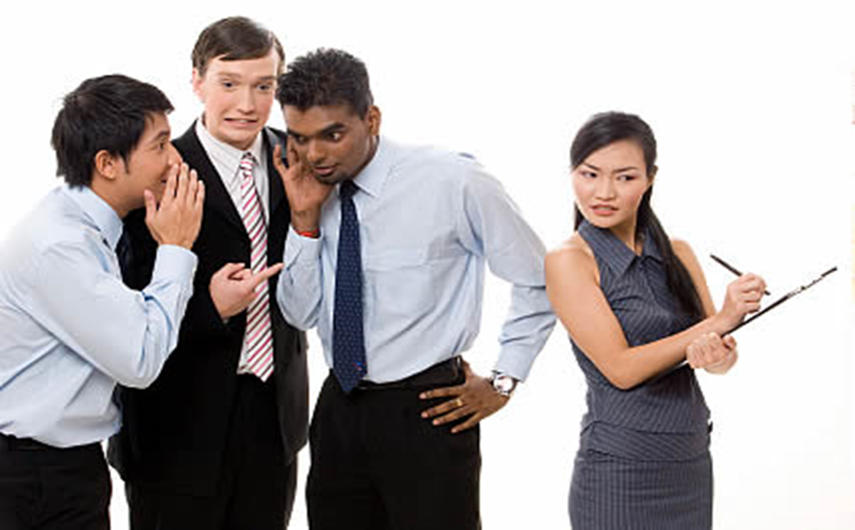
Transmission

Slide 25
Advantages of Grapevine
It carries information rapidly. When an employee gets a confidential information, he/she passes the details to his/her close friends and then it starts spreading automatically.
The managers get the reaction of the subordinates on the company policies. The feedback is quick compared to formal channels of communication.
It creates a sense of unity among the peers
It builds up group cohesiveness.
It serves as an emotional supportive value

Slide 26
Disadvantages of Grapevine
Carries partial information
Not at all a reliable/ credible source of communication as it does not follow any official channel of communication
The productivity of the employees may be hampered as they spend more time in gossip
Sometimes it creates a hostile environment in the organization

Slide 27
Thank You

